Slide 1


Creative approaches to building capacity
Presentation for the EDOREN closure event
26th June 2018

Slide 2
EDOREN Mandate (2013 – 2018)
To embed research, evaluation and learning
in DFID’s education sector support in Nigeria.
To enhance national capacities to generate and use evidence (quality educational data, research and evaluation) for policy and strategy making

Slide 3
Capacity
Capacity development is integral part of most projects and defined as “ability of individuals, organizations or systems to perform appropriate functions effectively, efficiently and sustainably”.
Notes:
Research institutions (SUPPLY): Lots of research for self promotion; Few commissioned research; Inaccessible to those who may use them
Decision-makers (DEMAND): Policy and practice of education ; Distrust of the supply side; Evidence shy

Slide 4
Capacity development plan
(Source: OPM/SIPU (2012)
 | Create | Use | Retain
Individual | adequate skills, knowledge, competencies, attitudes | Workplace Application | facilitation within institutions
Organisational | Establish efficient structures, processes and procedures | Integration in the daily workflows | Regular adaptation
Policy Environment | Establishment of adequate regulations | Enforcement of regulations | Regular adaptation regulations

Slide 5
Holistic approach to capacity building
Institutional Capacity to collaborate, demand, seek and use evidence for improving the quality of education decision
Individual capacity for multisectoral evidence generation and use for education decision-making
Need identification and Co-definition of the Problem
Develop Proposal for solving the problem
Design the approach, collect data, analyse and interpret findings
Communicate evidence using system-friendly strategies
Transform from generation to technical support

Slide 6
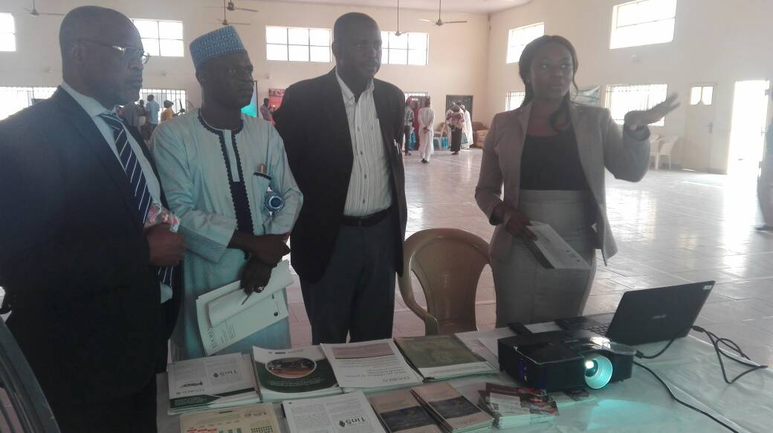
Market fair

Slide 7
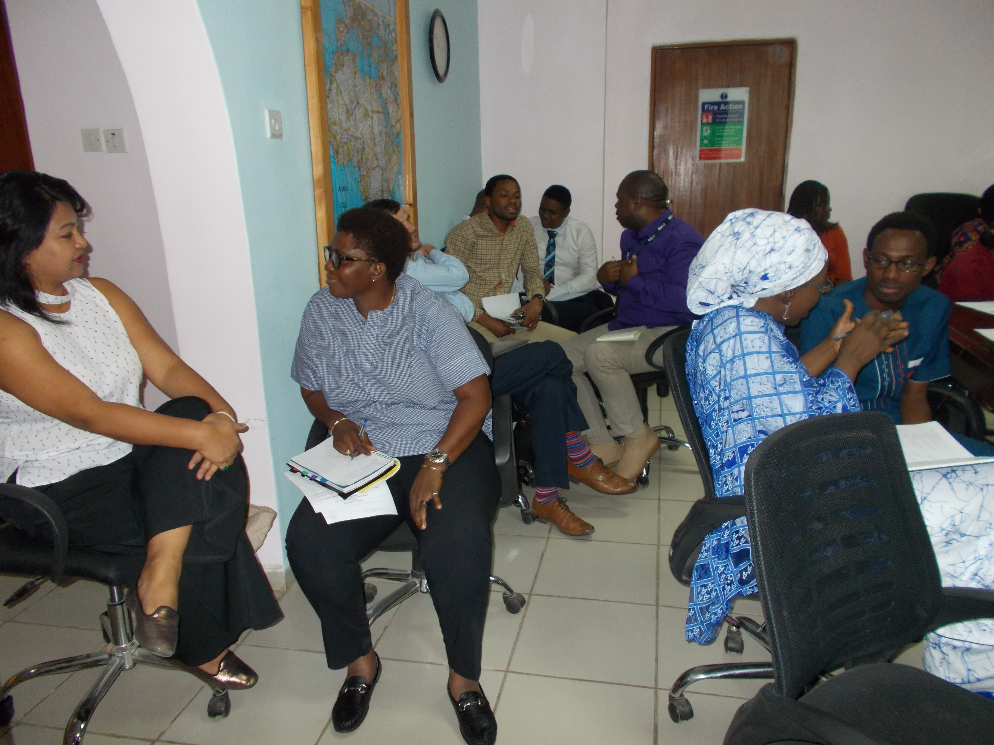
Portfolio meeting

Slide 8
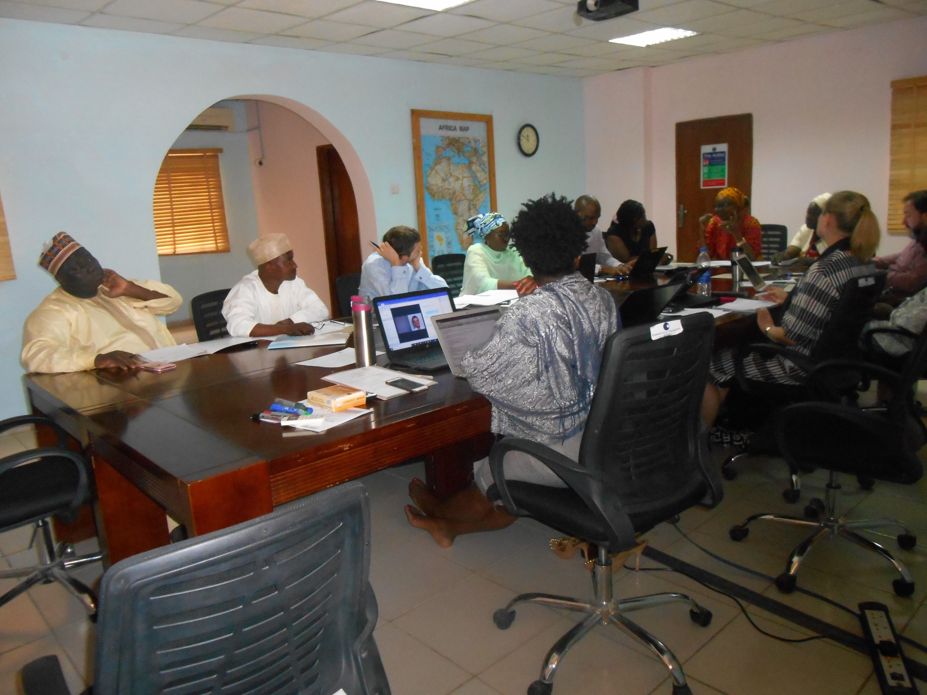
Steering committee meeting

Slide 9

Capacity development opportunities
Primary School Teacher Management Universal Basic Education Reform Review
Identifying, Recruiting and Deploying Effective Teachers
Factors that influence evidence uptake into education policy and practice

Slide 10
The Grant-making approach
Call for Expression of interest
  Compliance with team composition conditions
  Ideas for resolving the problems
Awards to best team in each State
  Joint problem definition
  Agreement on what evidence is required for informed decision.
Proposal development
  Policymakers
  Research institutions (academia)
Team Mentoring and facilitation
  Research proposal refinement (design, methodology, instrument)
  Data collection
  Communicating the finings to the demand side and the wider public
  Stakeholder processes

Slide 11
Collaborative State Research Capacity Strengthening team
MoE/SUBEB Steering Committee
4. Repeated Policy Feedback
Senior Policymakers
2. Partnership
Senior Academics
Academics: Provide better, and more relevant evidence for education policy
Policymakers: Provide better understanding and use of evidence for education policy
Improving Useage of Evidence for Education Policymaking
3. Mentoring
Junior Policymakers
Junior Academics
5. Hands-On Support
EDOREN

Slide 12
The team
Research teams
2 Senior (1 Academia, 1 policy)
2 Midcareer (1 Academia, 1 policy)
4 Early career (2 Academia, 2 Policy)
2 Civil society members

Slide 13
Capacity building Structure
Research Team: Senior, Middle and Early career
Facilitator [Local]
Mentors [External Consultants]
Notes:
State Research Team – contract, availability, compliance, engage with State (reporting, accounting). Intra-team capacity development
Facilitator--- Hands-on activities (Fieldwork, data software use, analysis, draft reports, trouble shooting
Mentors– Quality assure, transition phase workshops, finalise reports
EDOREN-–grantmaking, accountability , workplan, finance

Slide 14
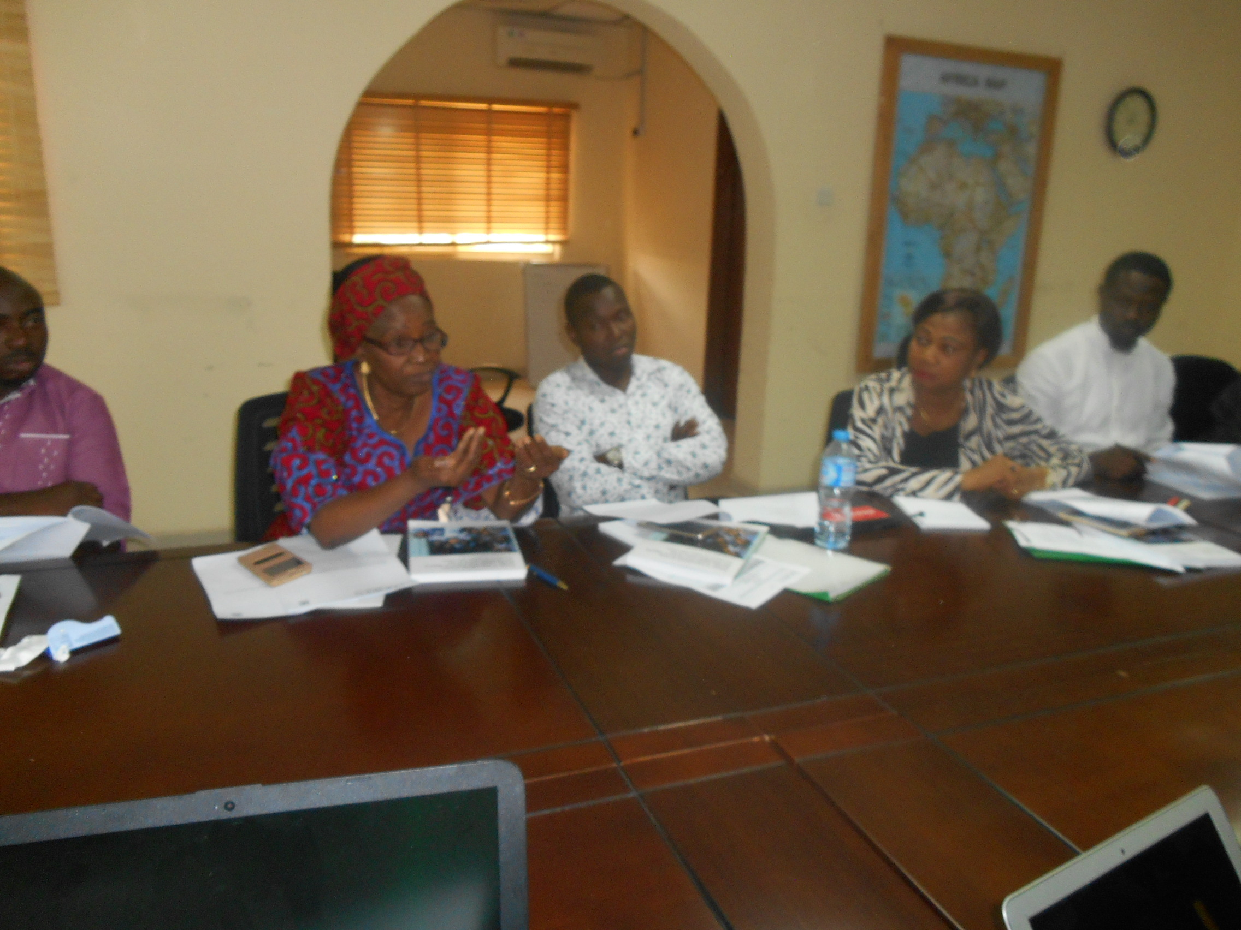
Our Capacity focus
Capacity focus
Develop Proposal, design issues and tools
Bond, team work Collaborate
Research and donor management
Mix-methodological approach
Research communication

Slide 15
Individual Capacity
Collaboration between supply and demand side
Evidence generation skills
  Proposal development , investigation designs
  Data collection, analysis and interpretation
  Use of software for data collation and analysis
Evidence Communication skills
  Reporting
  Social marketing approach to evidence uptake
Technical support for evidence uptake

Slide 16
Individual Capacity building
Workshops
Hands-on facilitation and Practice Labs
  Formal training workshops (software use, communication: Atlas.Ti; Epidata and Excel
  Report Writing
Seminars
  Effective Communication Strategies
  Remote feedback
Mentoring
  External consultants remote and one-on-one coaching and feedback

Slide 17
System strengthening
Technical Support to government
  Within reach
  Relevant, Contextual and practical
Training
Development of Screening Tools
Development of teacher Policy documents
Monitoring the recruitment process
Resource team for evidence-based education decision-making

Slide 18
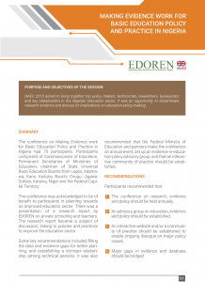
How to manuals...
How may I get a copy of that NAEC manual? It is so useful an d I want to see how I can adapt it to a programme in Uganda.
Process manual for organising the NAEC

Slide 19
Collaborative fellowship
Inter-agency Bonding (CSOs, MoE, Academia, Political)
Inter- institutional capacity
Shared understanding
Intra-institutional process review and understanding
Evidence usage facilitation

Slide 20
Thank you http://www.nigeria-education.org/edoren/publications/ https://www.opml.co.uk/our-expertise/human-development/education

